Slide 1
Solo Project: DND Character Database
John Brockman

Slide 2
Brief
Solo Project
CRUD functionality
Full Stack Application
Using OOP + Core Java Skills
Relational Database
Fully Tested

Slide 3
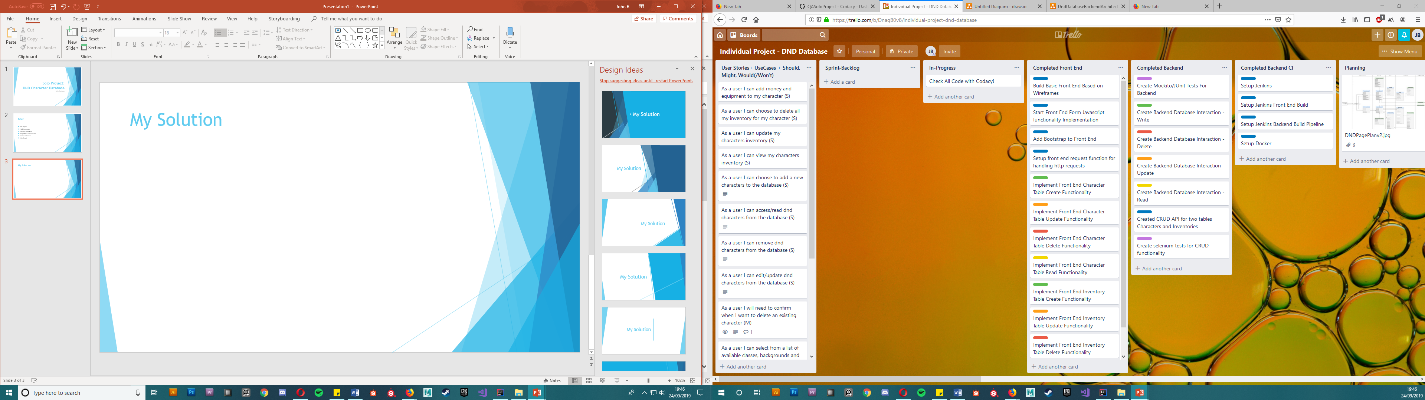
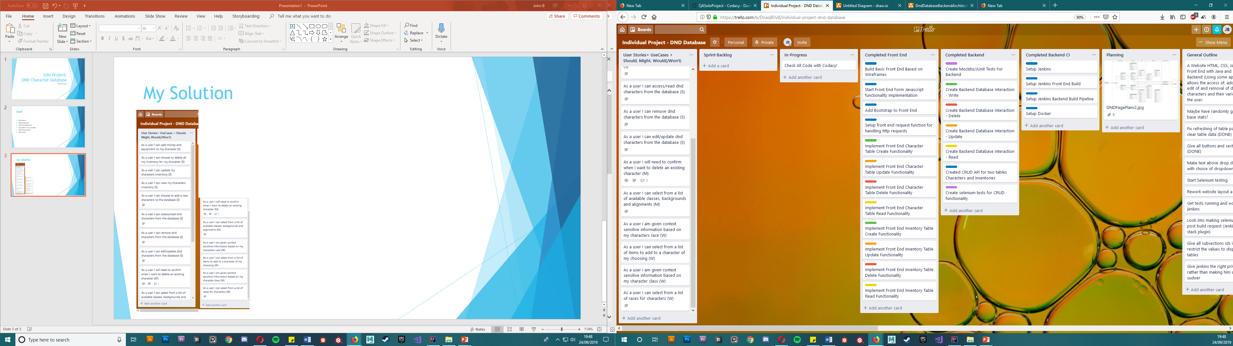
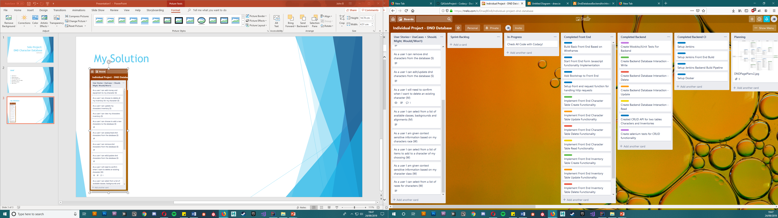
My Solution

Slide 4
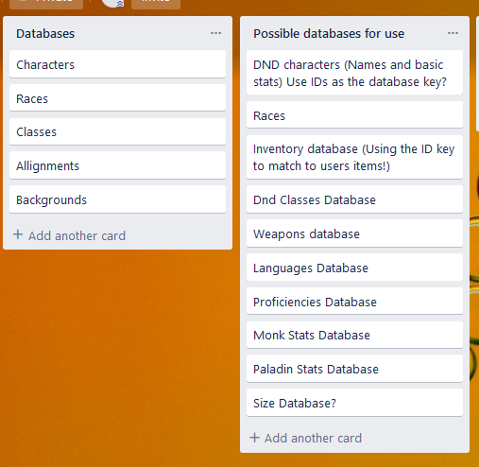
My solution

Slide 5
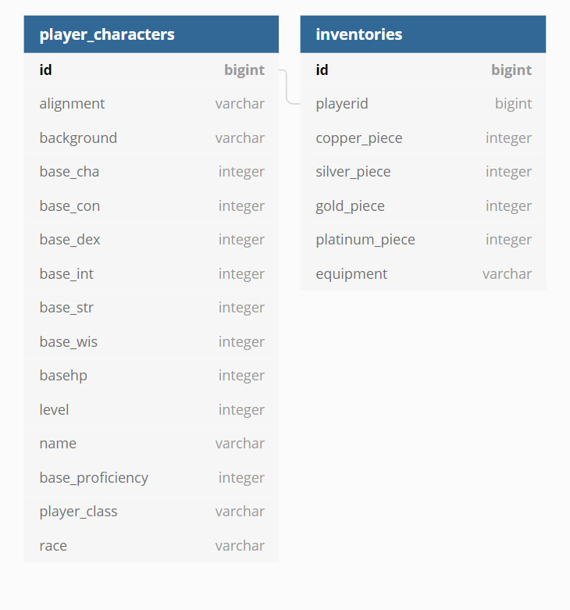
My Solution

Slide 6
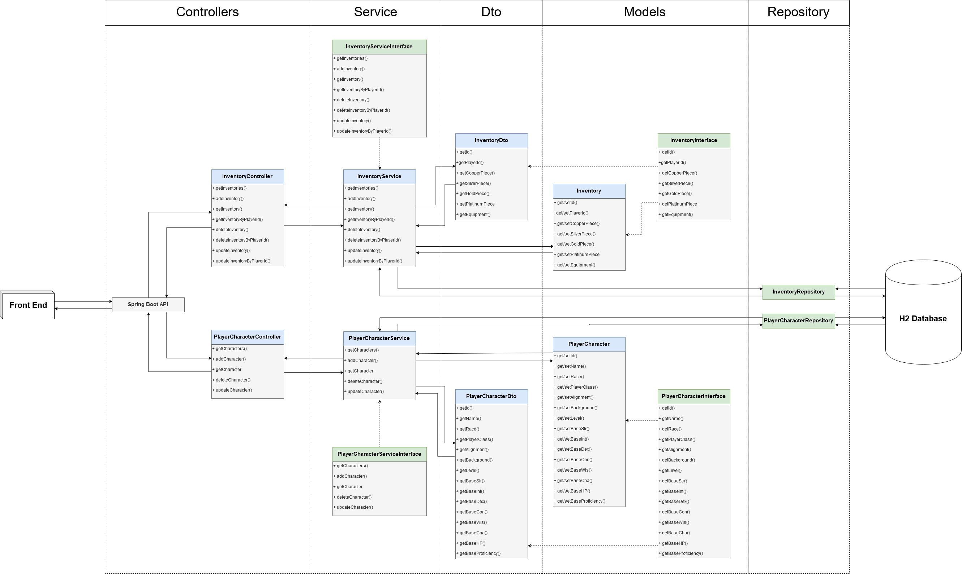
API Development

Slide 7
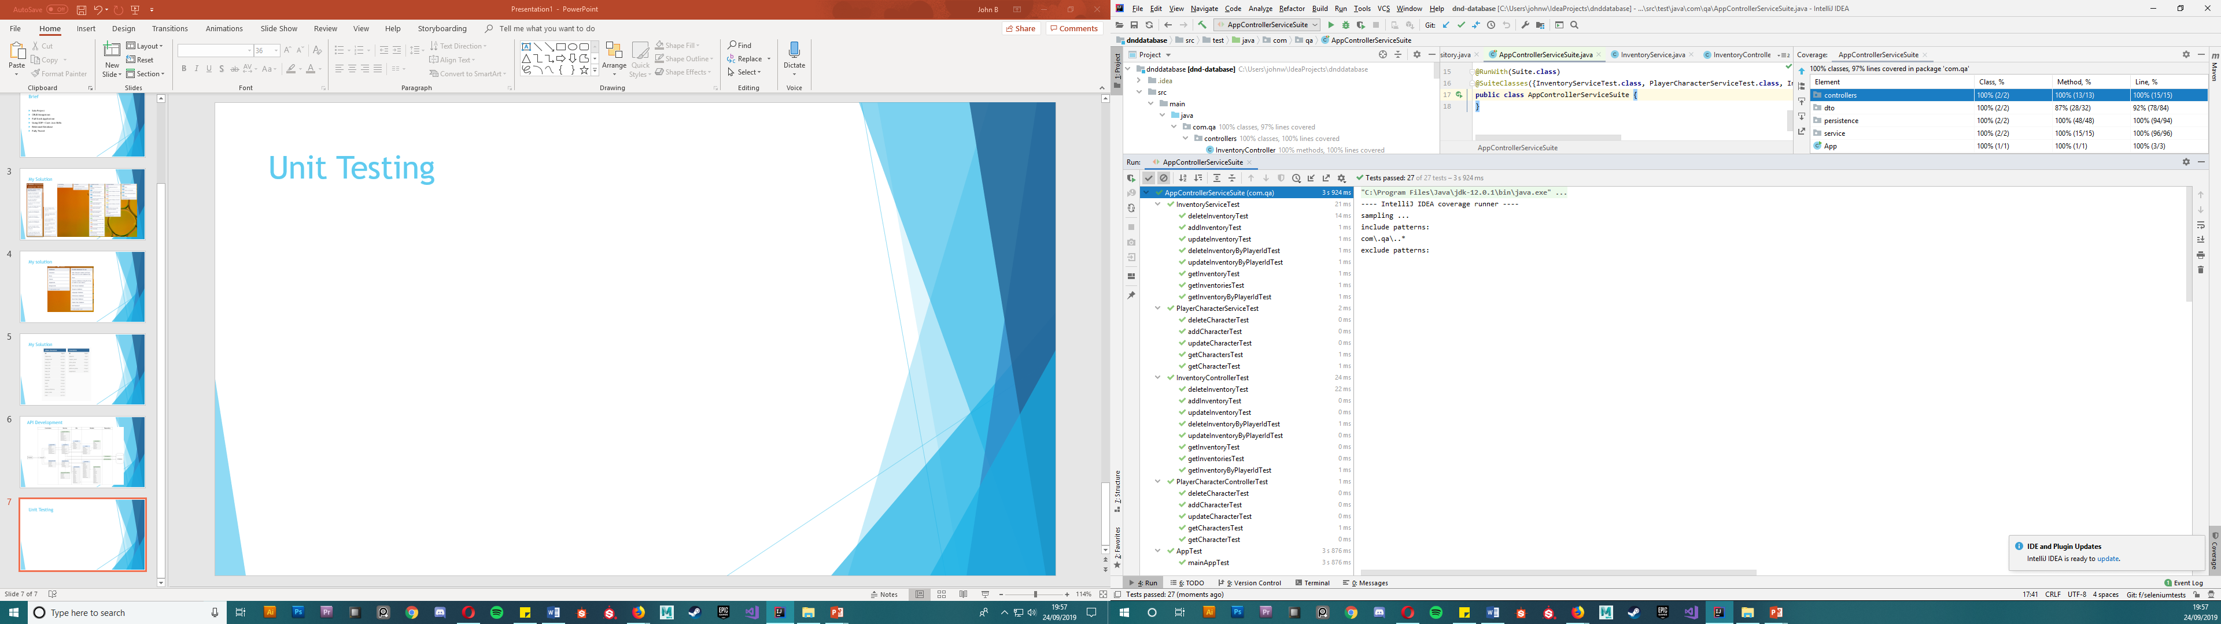
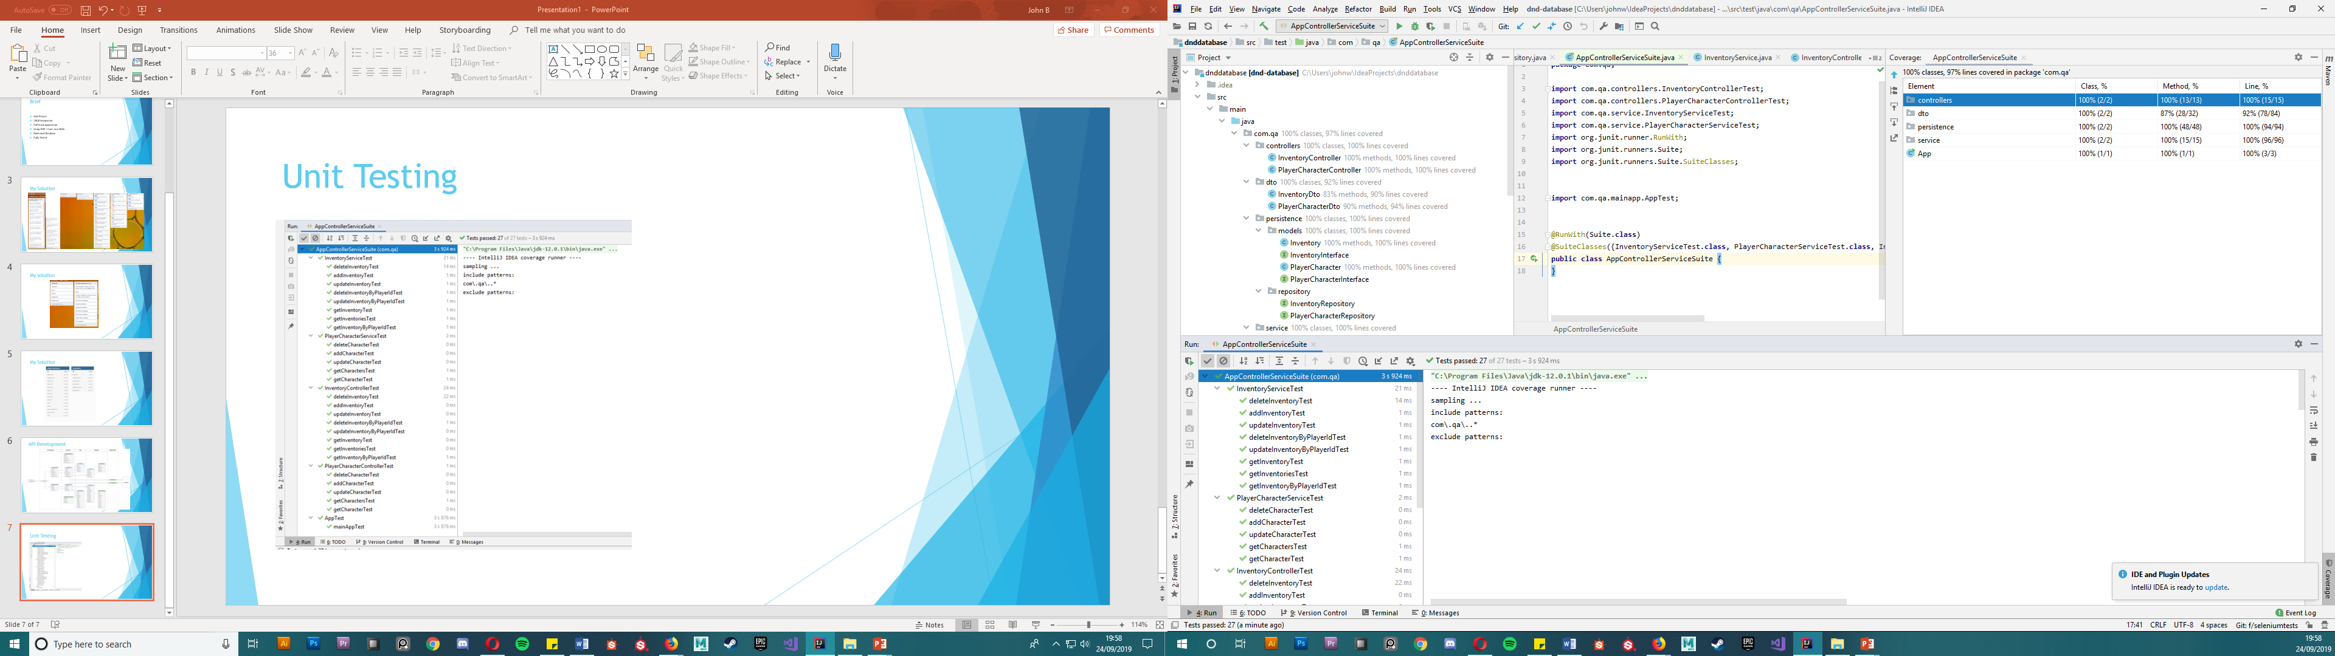
Unit Testing (Junit + Mockito)

Slide 8
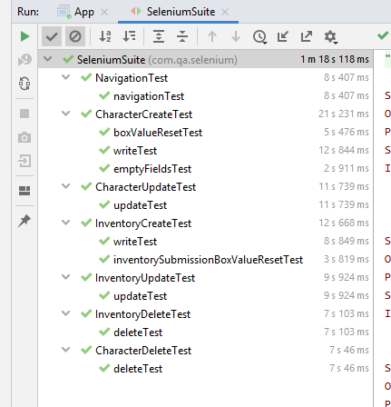
Selenium Tests

Slide 9
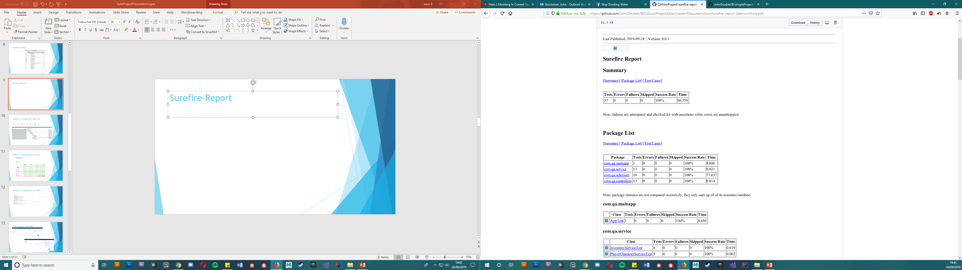
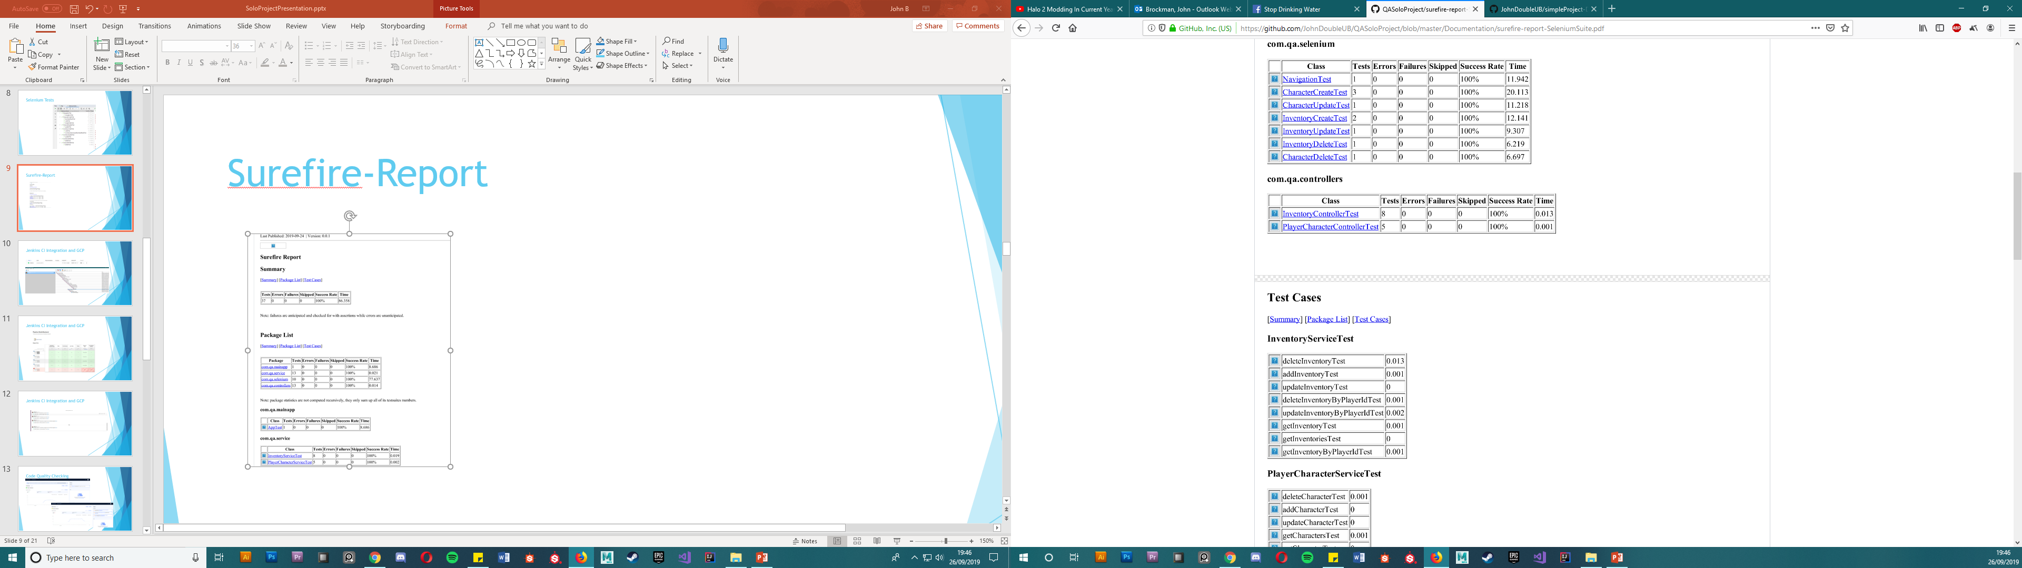
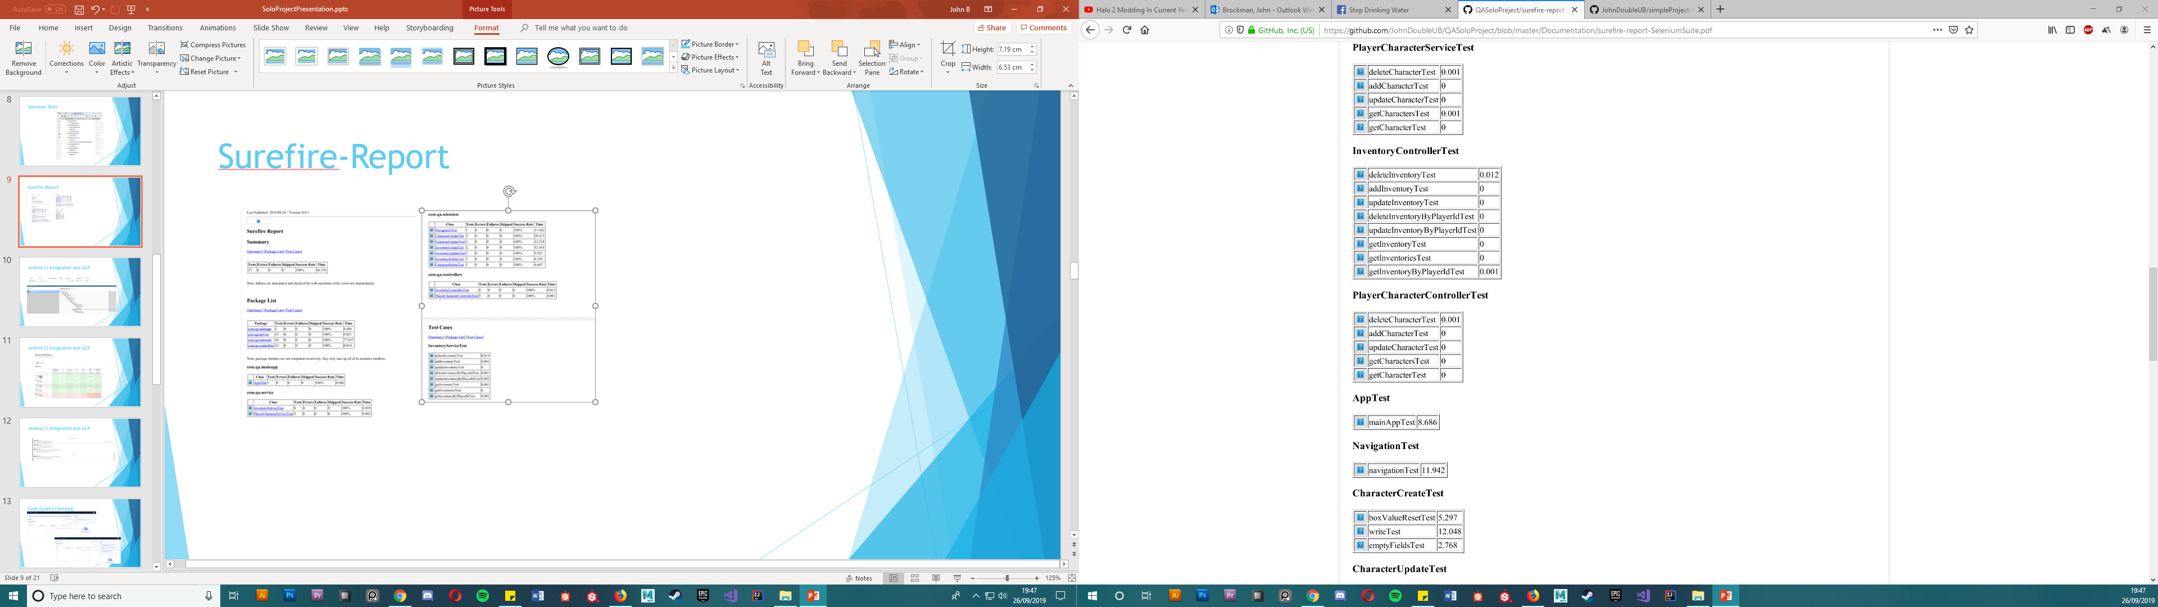
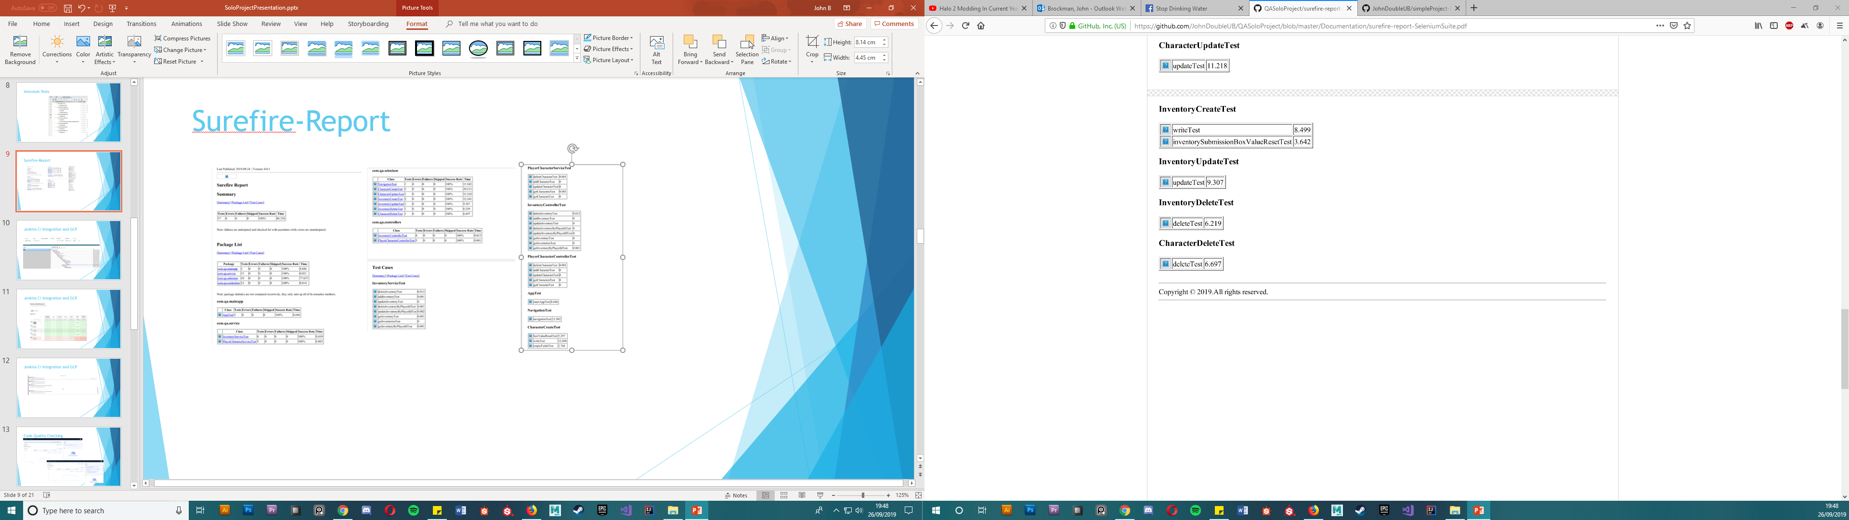
Surefire-Report

Slide 10
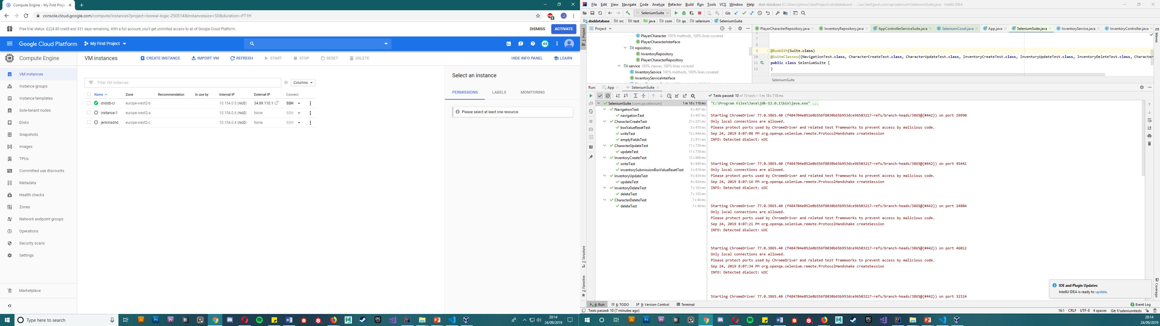
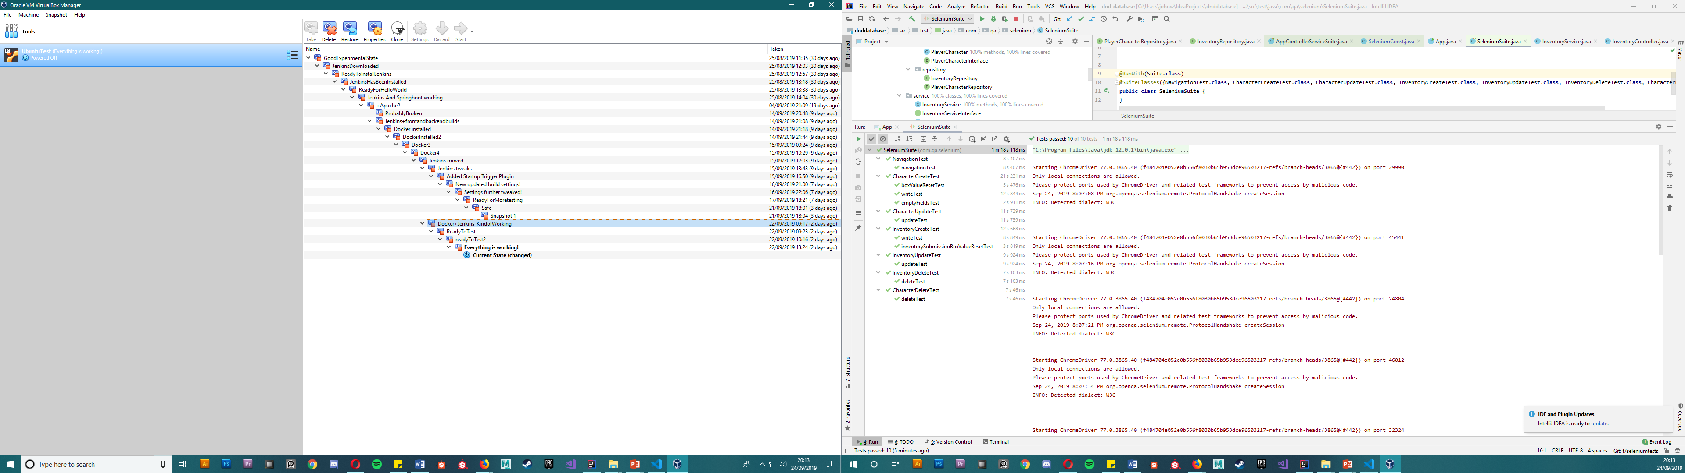
Jenkins CI Integration and GCP

Slide 11
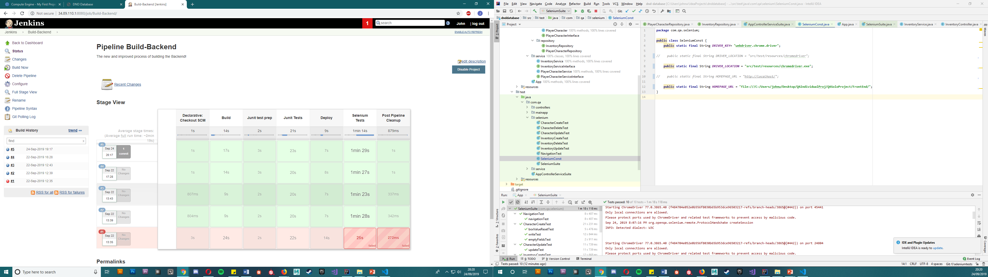
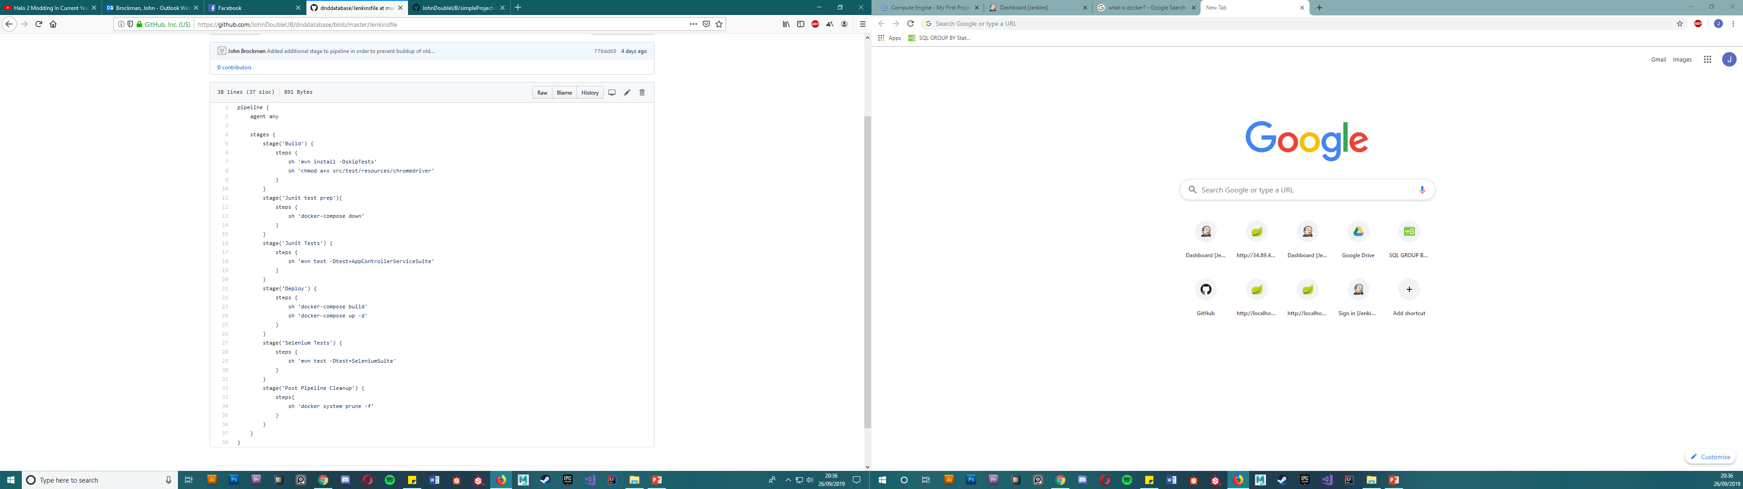
Jenkins CI Integration and GCP

Slide 12
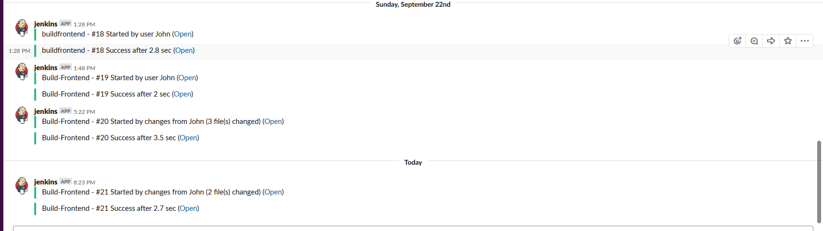
Jenkins CI Integration and GCP

Slide 13
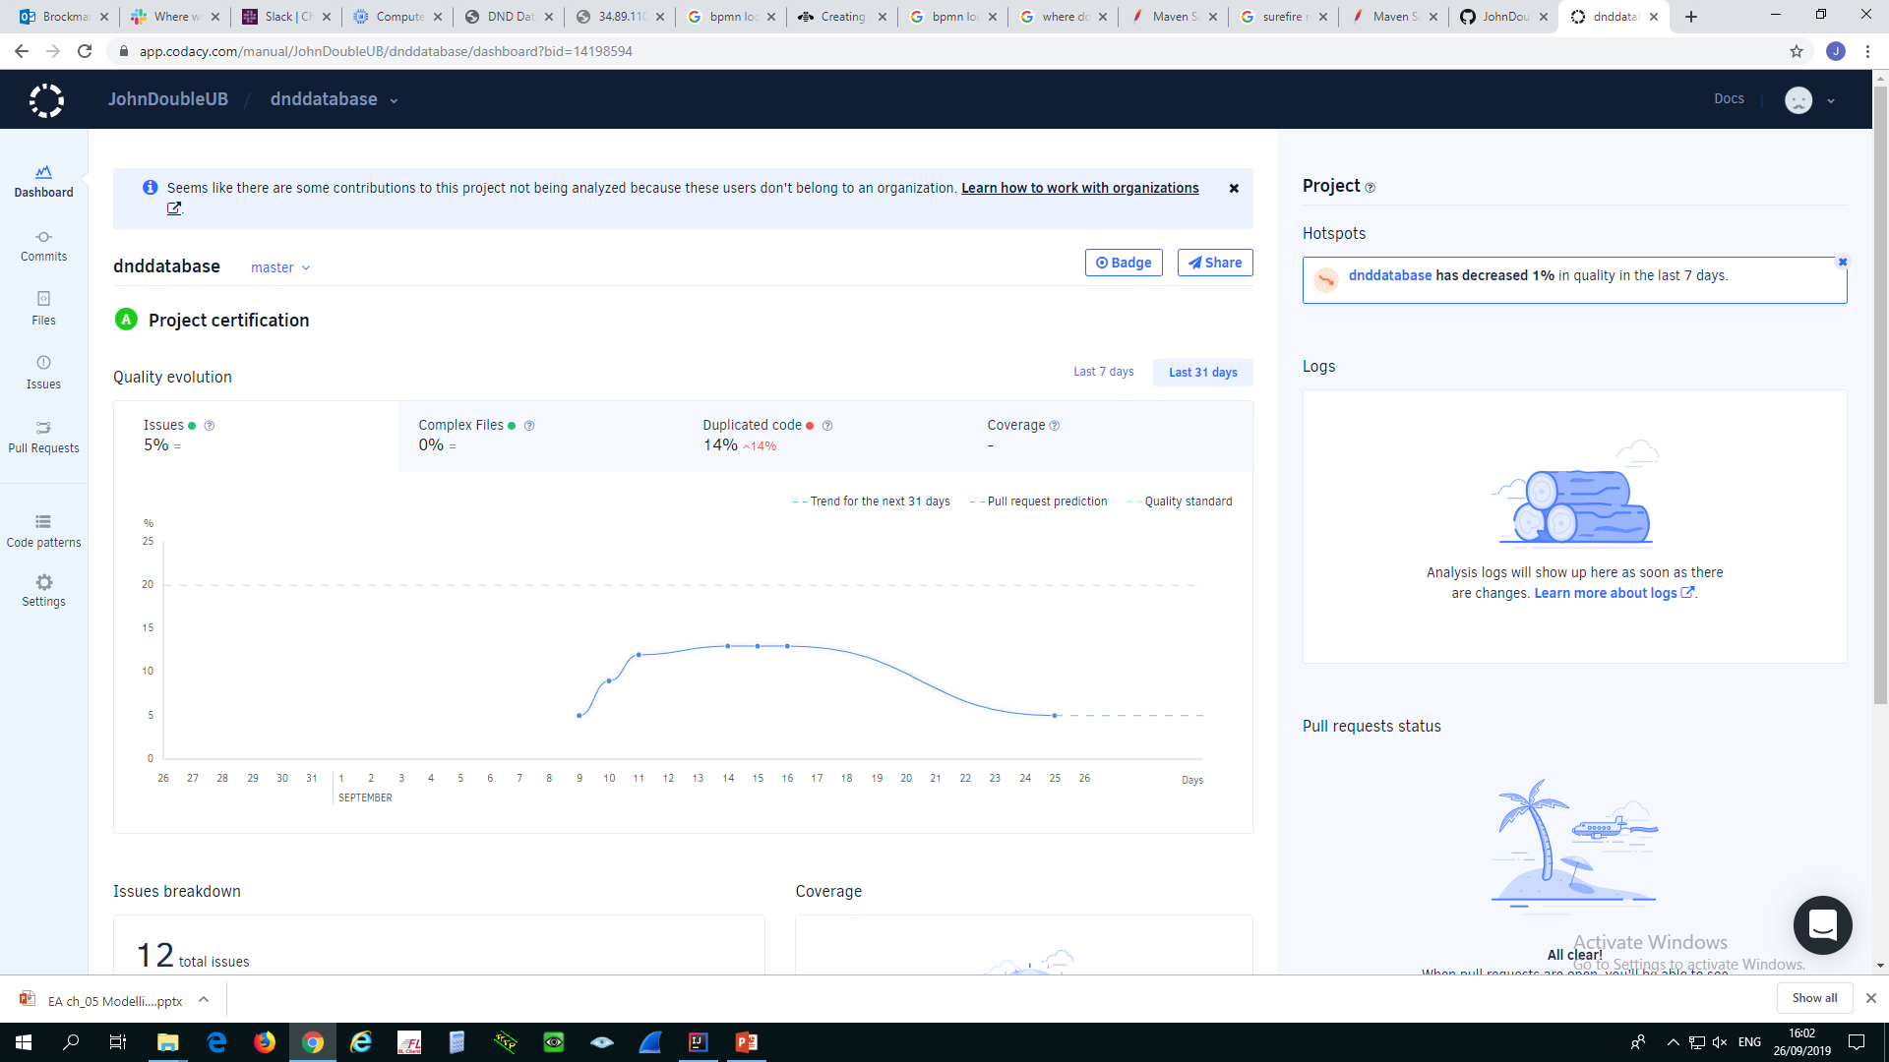
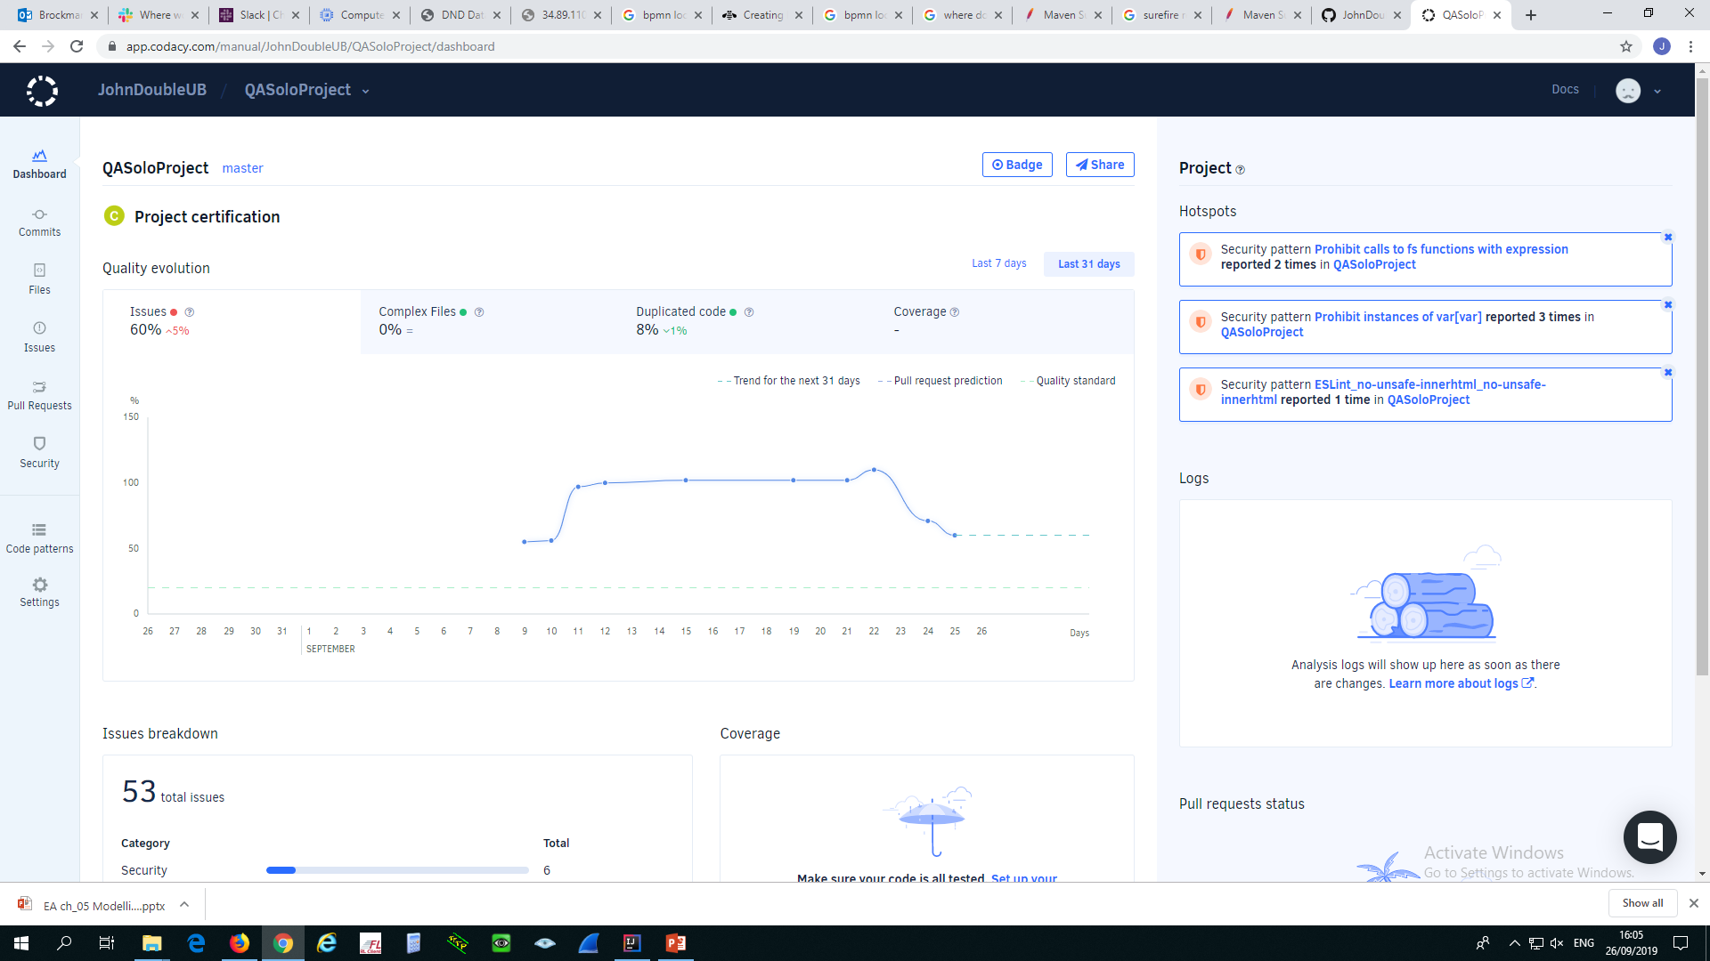
Code Quality Checking

Slide 14
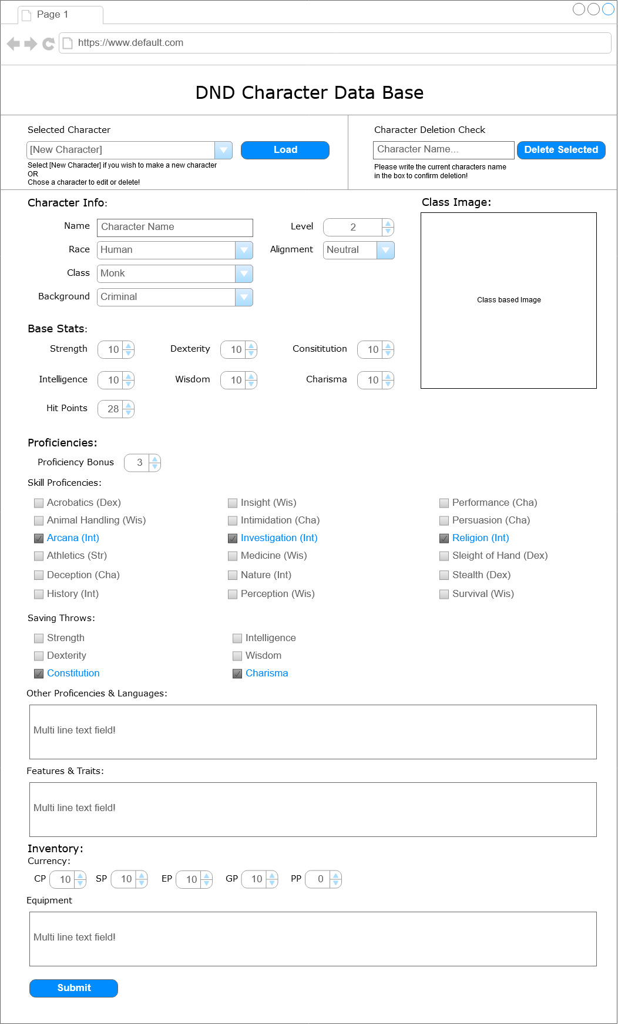
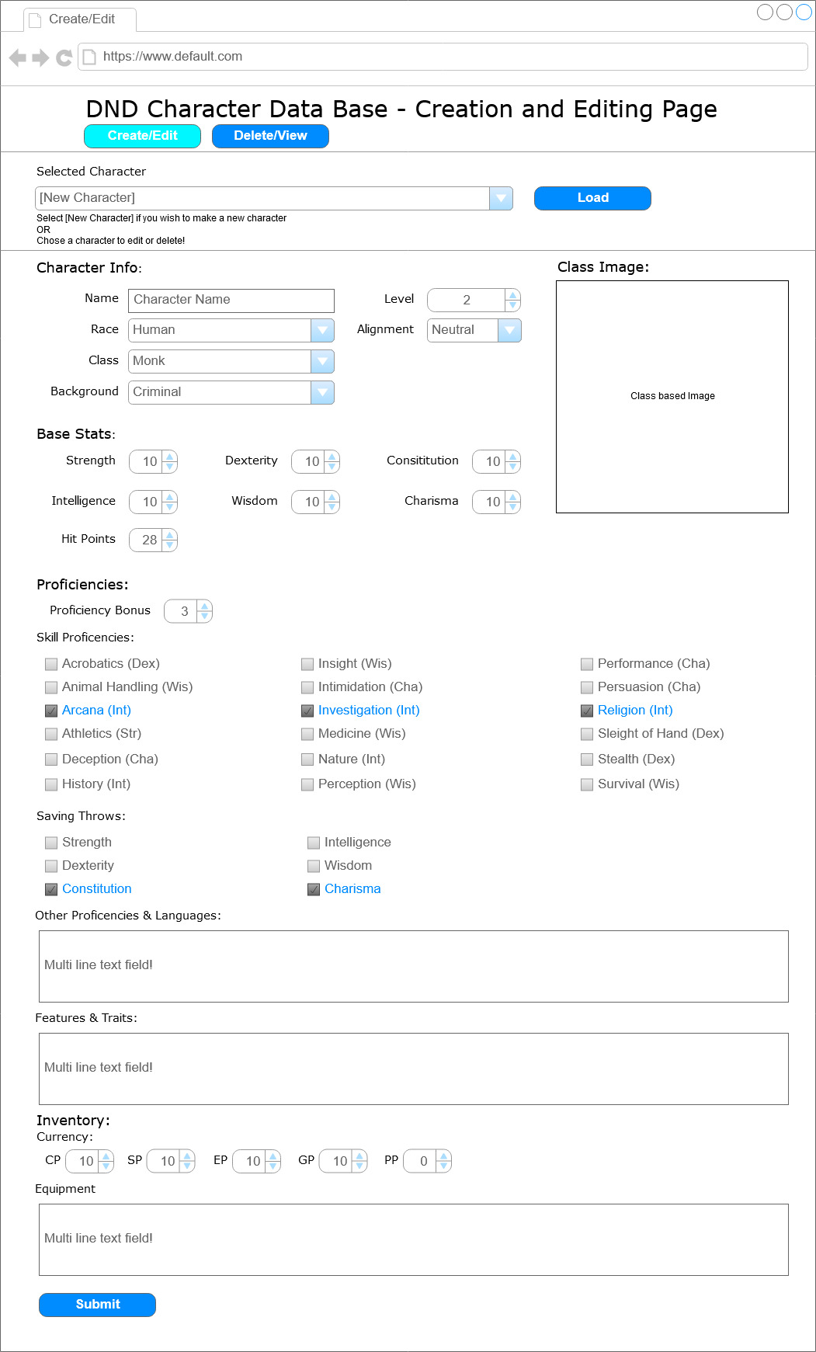
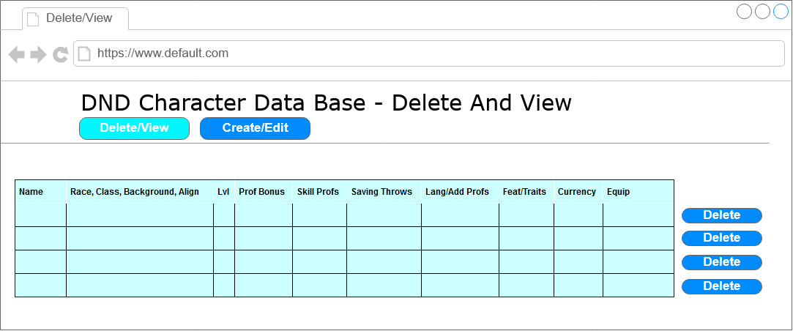
Front End - Initial Wireframes

Slide 15
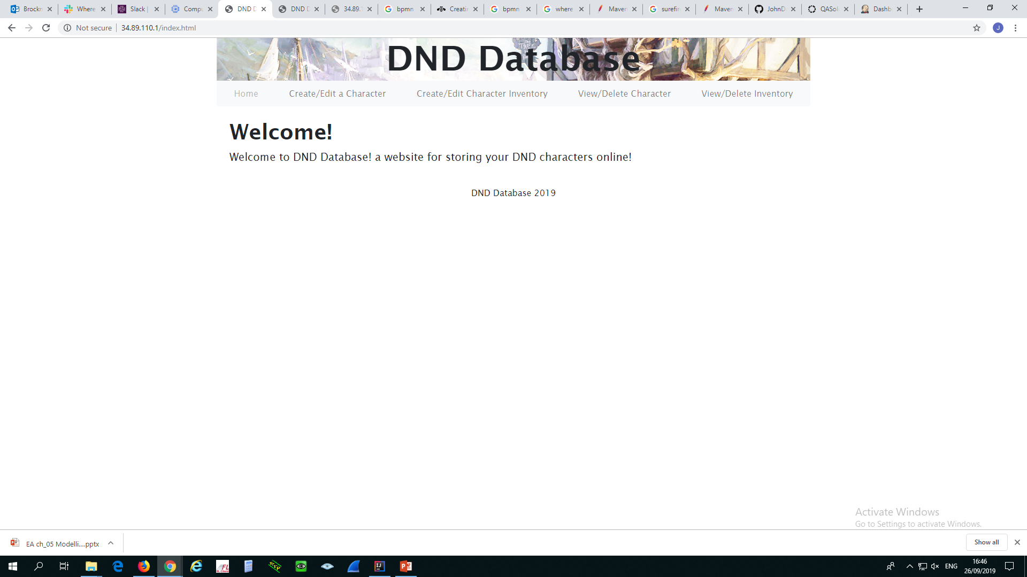
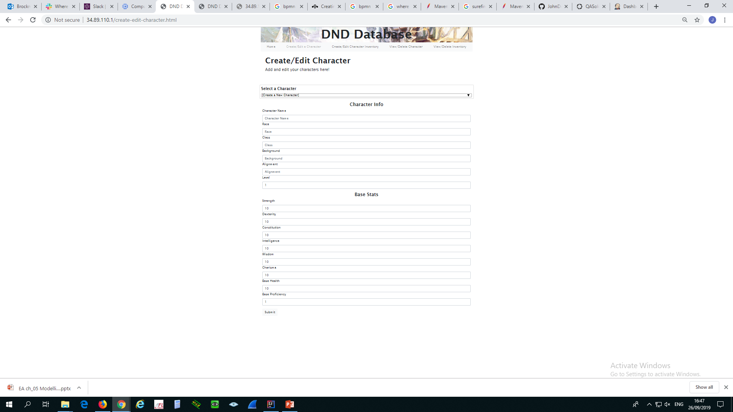
Front End - HTML, CSS, Bootstrap, JavaScript

Slide 16
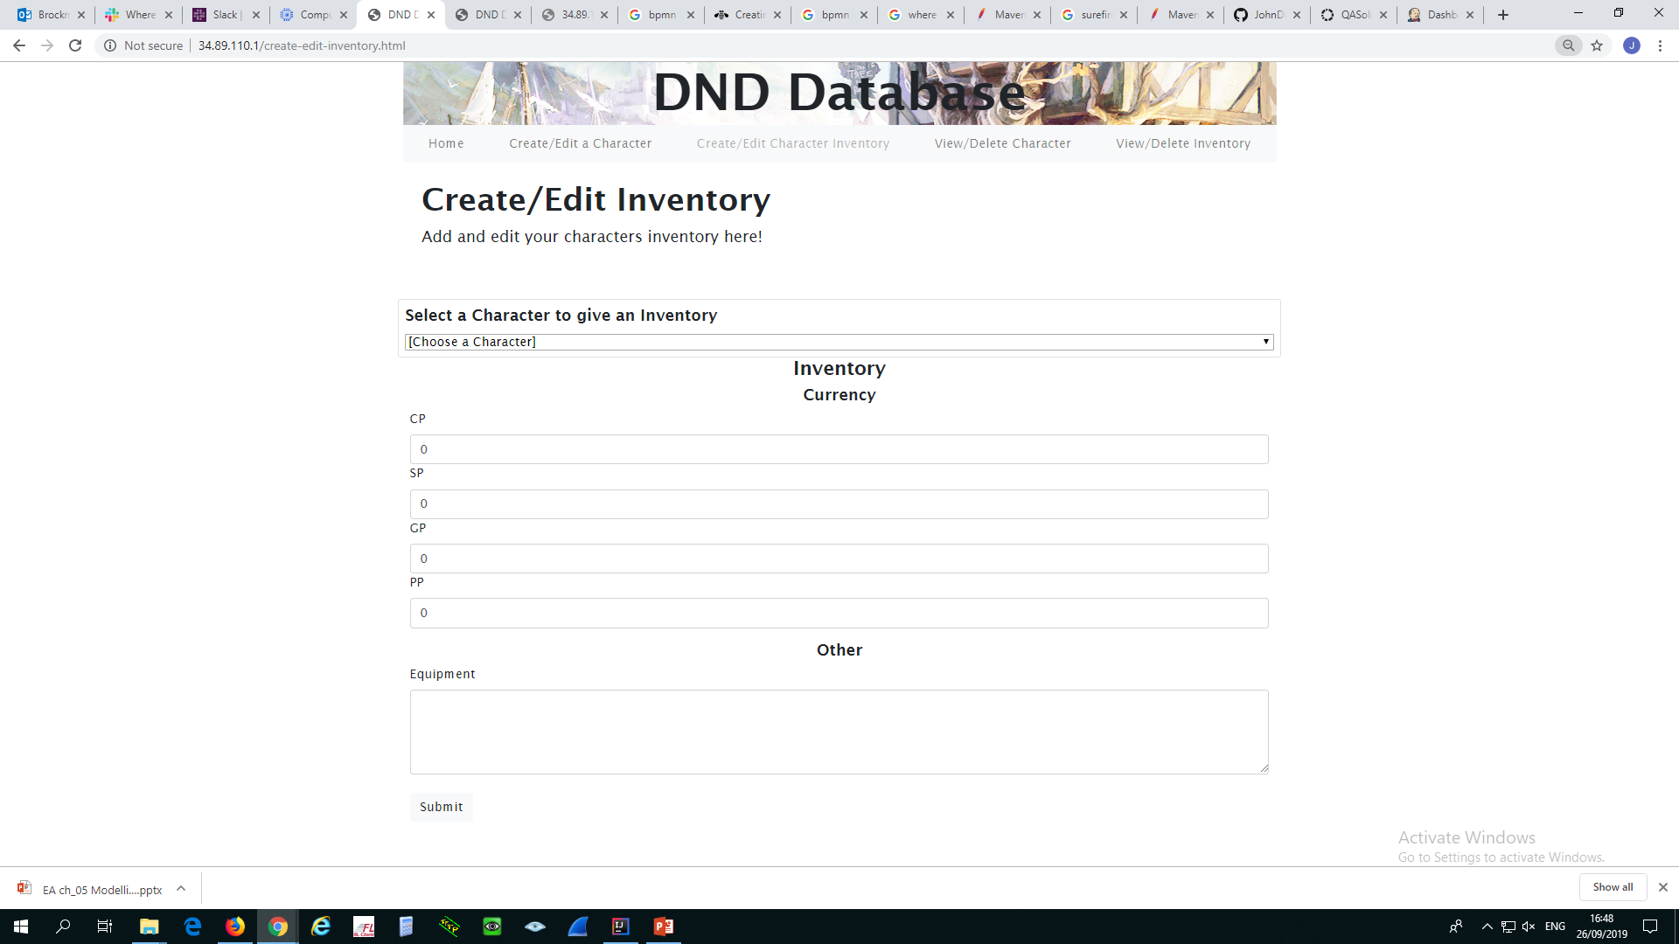
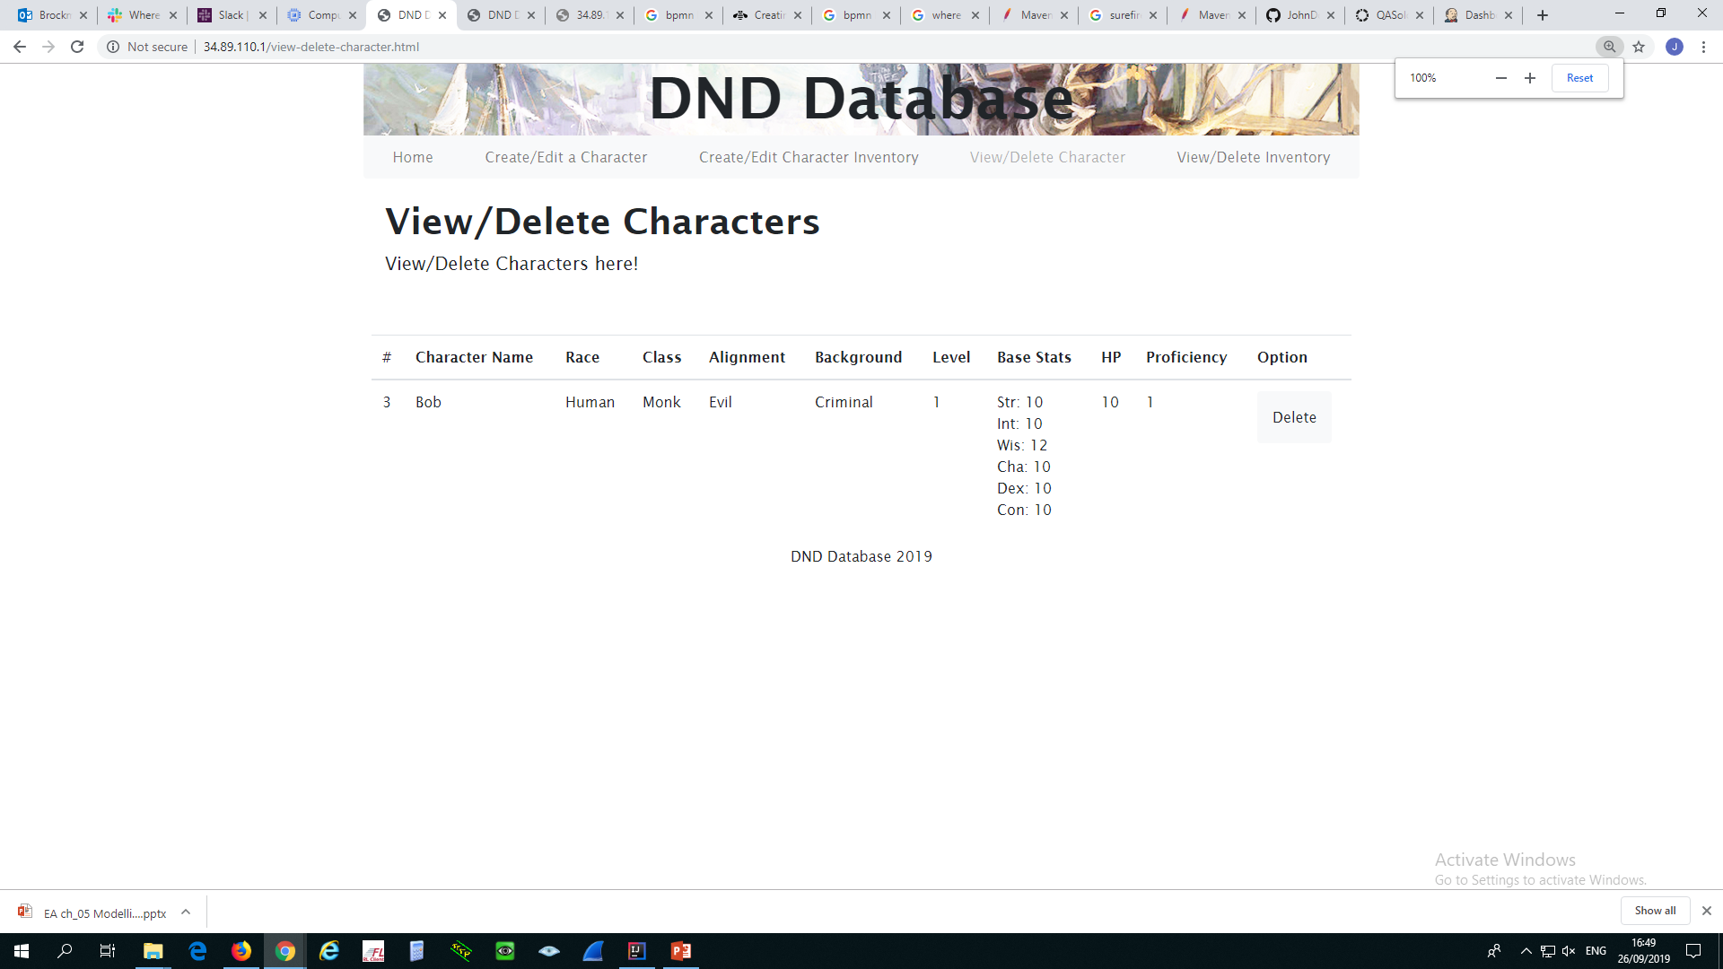
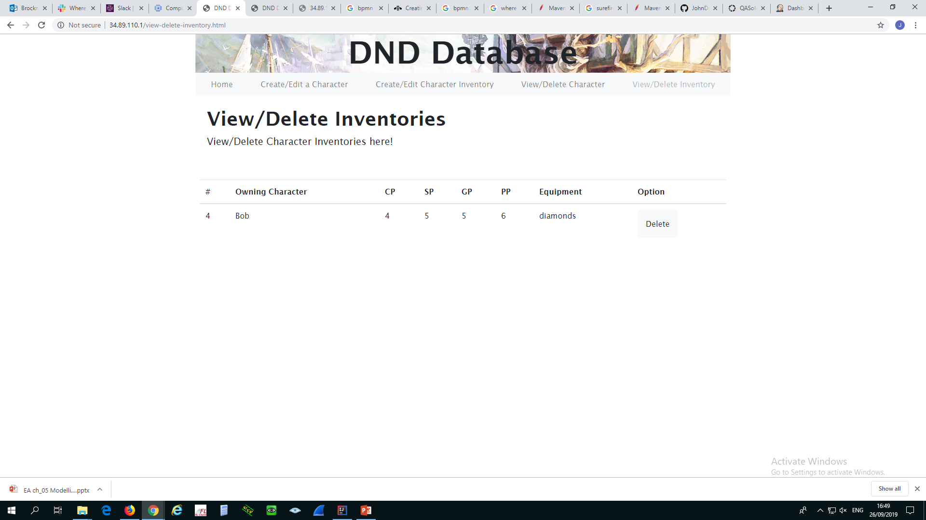
Front End - HTML, CSS, Bootstrap, JavaScript

Slide 17
Technologies
H2 Database Engine - Database
Java - Logic
Front-end - HTML, CSS, JavaScript, bootstrap
Backend API - Spring-Boot
Jenkins - CI Server
Docker - Containers
Maven - Dependency Management
Surefire - Test Reporting
Codacy - Code Quality Checking
Git - VCS Project Front End, Project Back End
Trello - Project Tracking
GCP - Live Environment

Slide 18
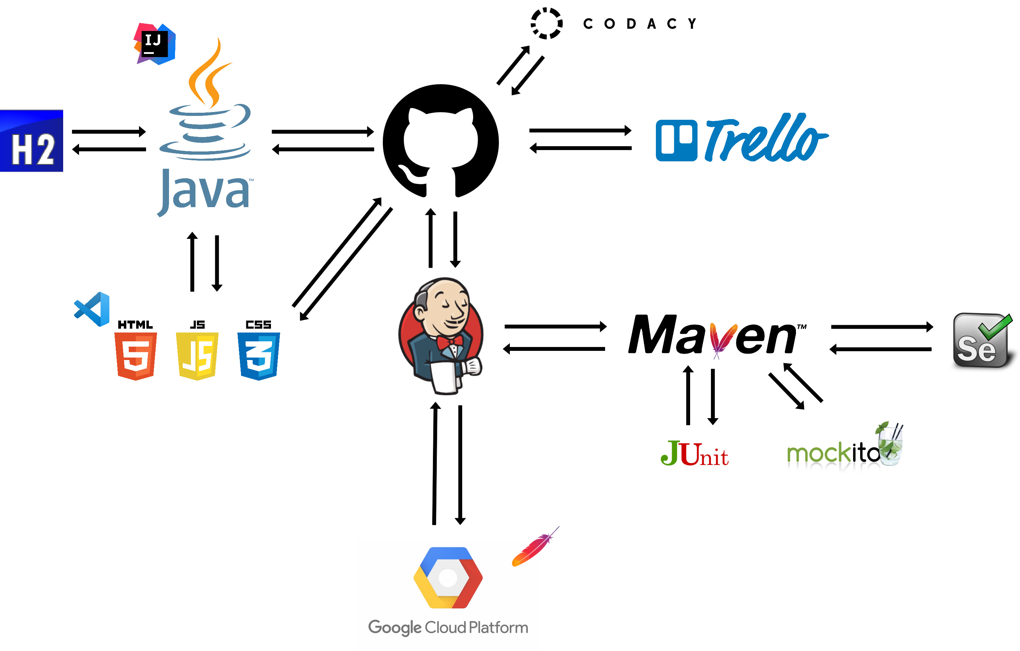
DevOps and Continuous Integration

Slide 19
Demonstration
http://34.89.110.1/

Slide 20
Summary
What went well
Database and CRUD functionality
Test Coverage
Code Quality Checking
Front End Testing
Use of CI Tools
Future Improvements
Bootstrap (Modals, General Appearance)
Front End code could be cleaner
Git VCS Branches
More Relational Databases:
- Items, Classes, Proficiencies

Slide 21
Questions?

